Slide 1

Understanding the
Escalation and De-escalation Process
KELLY OLDFIELD
GradDipPsych(Adv) BBS(Psych)
admin@cdbspecialists.com.au

Slide 2
Acknowledgement of Country
We recognise the First Peoples of this Nation and their ongoing cultural and spiritual connections to the lands, waters, seas, skies, and communities.
We acknowledge First Nations Peoples as the Traditional Custodians and Lore Keepers of the oldest living culture and pay respects to their Elders past and present. We extend that respect to all First Nations Peoples.
2

Slide 3
Introduction
  During the escalation process, a child encounters unresolved internal or external conflicts. The behaviours displayed at this stage can be challenging, disruptive, and carry risks, potentially causing harm to individuals in the surroundings and property damage.
  However, adults can influence several factors to lessen the chances of escalation and minimise risks. Having a thorough grasp of each stage in both escalation and de-escalation processes, along with applying efficient strategies, can have beneficial results for everyone concerned.

Slide 4
Influential
Factors
Room/Setting | Layout of area Tangible items within setting
Team Members | Body language Tone of voice Changes in Educators Positive interactions Non verbal body language
Learning | Boredom and learning difficulties Lack of rewards, Lack of Independence, Rushed and not enough time to processing
Room Practices | Consistency and predictability especially around routines and transitions
Social Interactions | Interaction style Active supervision Role modeling Expressive language skills Social skills
Sensory | Lack of access to breaks or consistency to breaks Over or under stimulated responses to behaviours Effectiveness of sensory activities.
External Factors | Relationship and communication with families, schools and therapists
Focusing solely on an individual's behaviour is not enough to establish long-term practices that can mitigate risks and improve results.
While some factors may be out of one's control, it is vital to identify the areas we can influence and make any required adjustments.

Slide 5
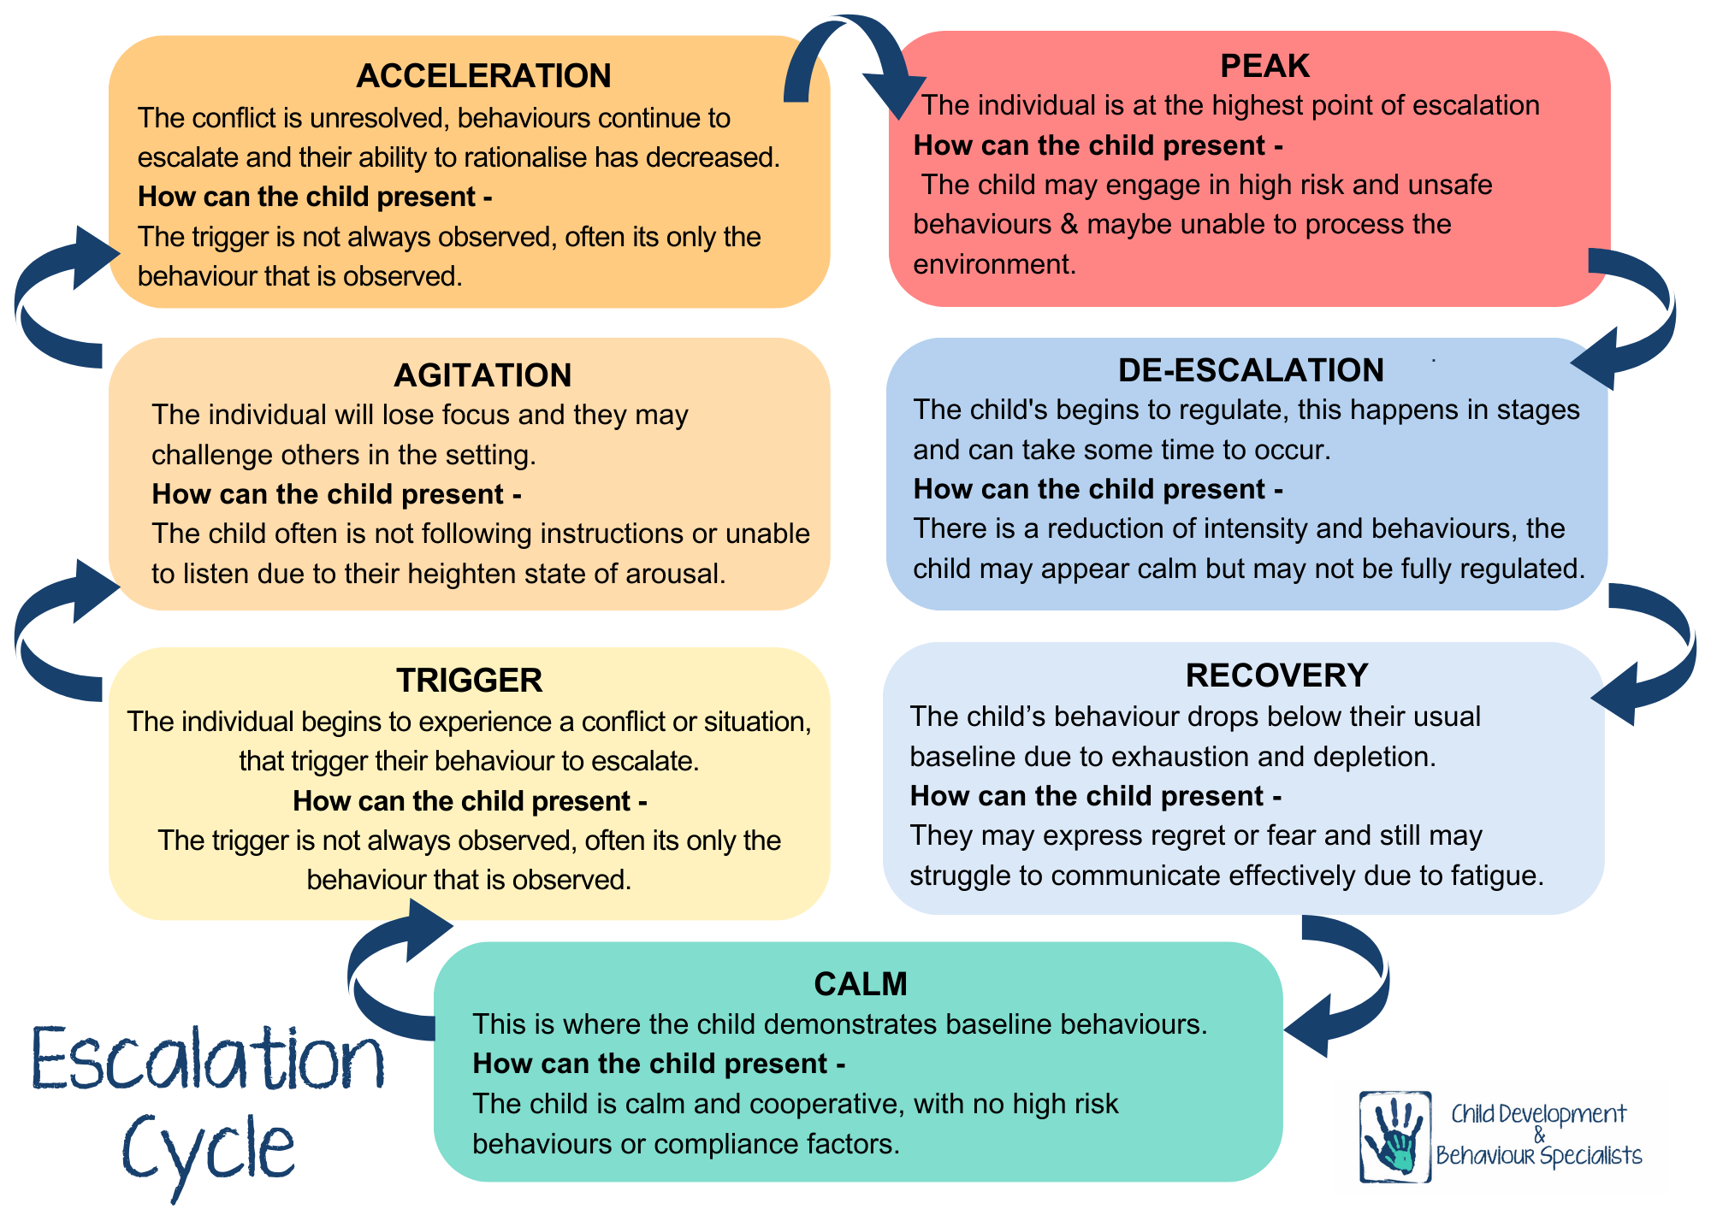

Slide 6
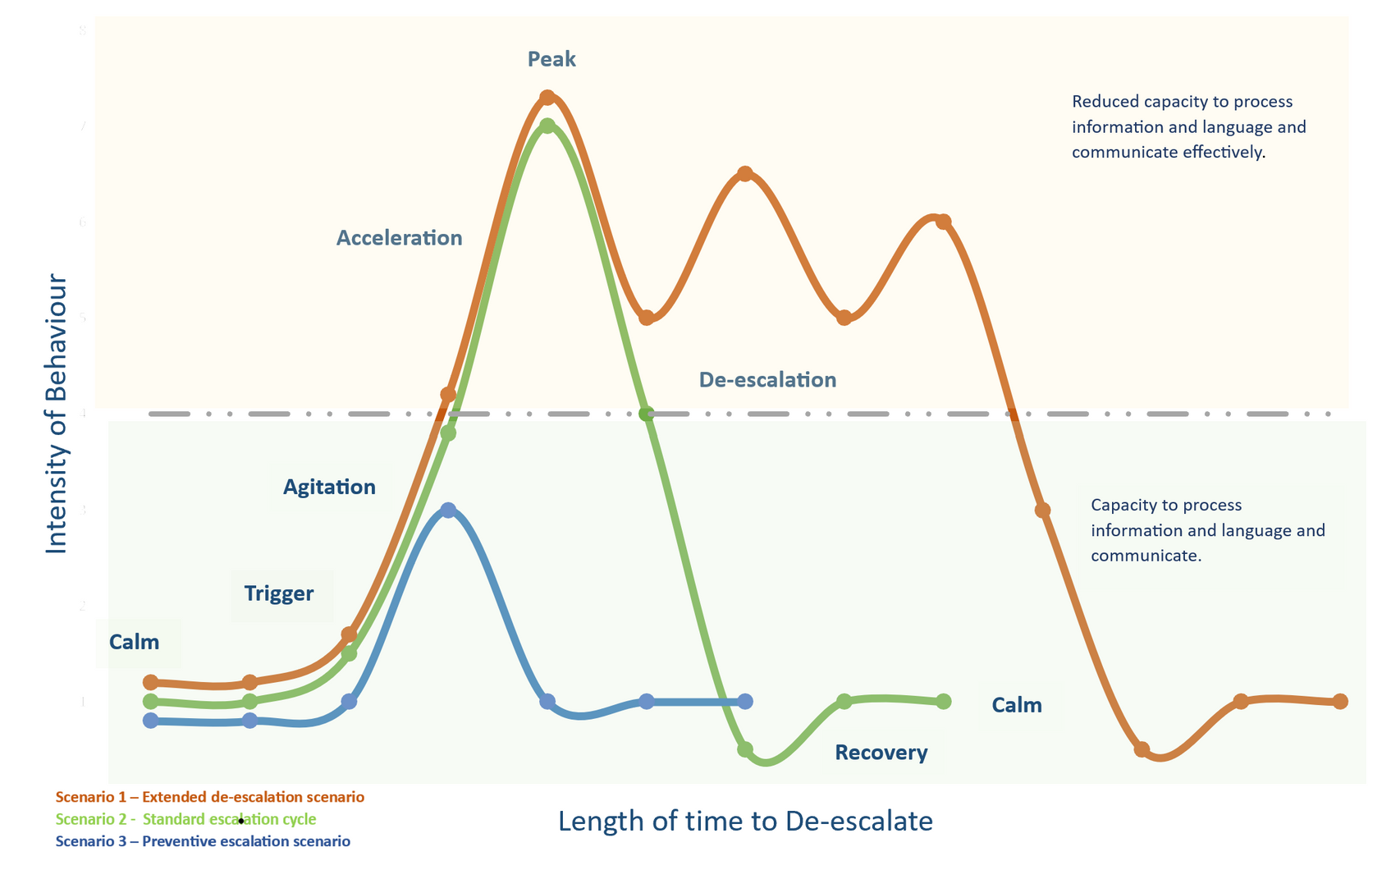
Escalation and De-Escalation Model

Slide 7
Preventative Escalation Strategies
CALM
Visual support to assist with learning behavioural expectations.
Consistent Positive reinforcement behaviour structures are in place.
Teach appropriate and replacement behaviours for challenging and unacceptable behaviours.
Establish predictability and consistent structures to support positive behaviour strategies.
TRIGGER
Remove or adjust controllable trigger if appropriate.
Address the trigger at that point as a priority. Do not wait for the behaviour to escalate.
Remind the child of other ways to access more appropriate behaviours.
Reinforce small efforts to redirect behaviour.
Offer choices.
Decrease or change expectations of current task if identified as a trigger.
AGITATION
Break down instructions to increase positive reinforcement.
Ensure you are listening .
Allow extra processing time for instructions and expectations.
Use visual supports instead of verbal prompts.
Use redirection.
ACCELERATION
Move other people in the environment away.
Monitor the environment for safety.
Remain calm and display neutral body language.
All learning or teaching on hold.
Minimise verbal interactions.
Minimise controllable factors to reduce the need to use physical contact.
Provide a safe space.

Slide 8
Effective De-escalation Strategies
PEAK
Eliminate verbal interaction.
Maintain calm body language.
Read child’s body language.
All learning and teaching on hold.
Check in with your volume and tone of voice.
Be mindful of your proximity to the student and consider risks in the environment.
Be mindful of the adult/student ratio.
DE-ESCALATION
Validating conversation.
Read children’s body language and de-escalation patterns.
Be mindful of proximity to the student and potential risk in the environment.
Show open and receptive body language.
Use clarifying statements to assist meaning.
De-escalation is the only expectation during this time.
RECOVERY
Validating conversation.
Emphasise a fresh start.
Offer choices in conversation if needed.
Reinforce positive behaviour.
Prepare children for changes or transitions
Ensure basic needs are met.

Slide 9
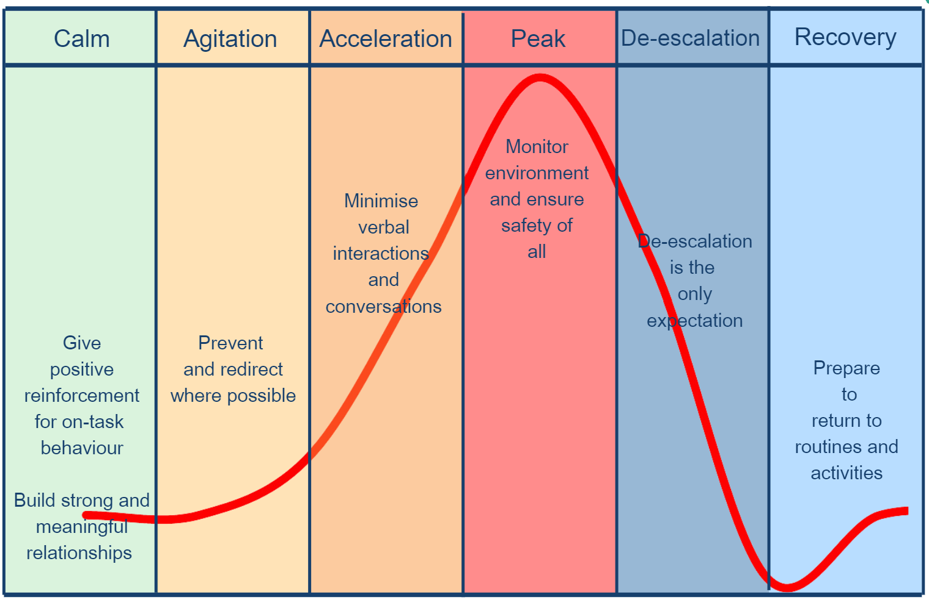
Escalation Profile

Slide 10
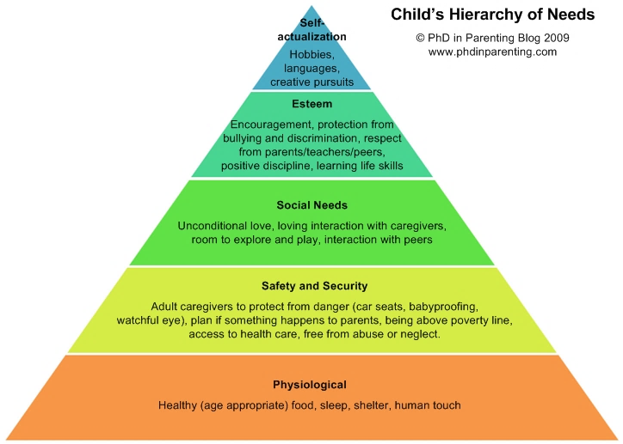
Maslow's Hierarchy
In learning environments, educators who help children meet their fundamental needs at the bottom row, pave the way for addressing higher-order needs.
By supporting children in fulfilling these basic requirements, educators can minimise spikes in escalation and enhance
de-escalation results.
This is particularly crucial as some children may face challenges in effectively communicating their internal experiences due to various factors.
10

Slide 11



Contact
Email: admin@cdbspecialists.com.au
Website: www.cdbspecialists.com.au
Online Learning Platform: https://learning.cdbspecialists.com.au
FILIT Website: www.filit.com.au
Email: support@filit.com.au
11

