Slide 1


Identifying
Function of Behaviour
and
5 Step Behaviour Modification
Child Development and Behaviour Specialists
KELLY OLDFIELD
GradDipPsych(Adv) BBS(Psych)
admin@cdbspecialists.com.au

Slide 2


Acknowledgement of Country
Child Development and Behaviour Specialists acknowledge the Traditional Custodians of country throughout Australia and their connections to land, sea and community. We pay our respect to their Elders, past and present and extend that respect to all Aboriginal and Torres Strait Islander peoples today.
2

Slide 3
Introduction
A behaviour is an action, process or activity which begins with a response to external or internal stimuli. These behaviours can be observed and measured to support the behaviour modification process.
Human behaviour can be categorised into four Functions of Behaviour
  Attention
  Tangibles or Activities
  Escape or Avoidance
  Sensory
Functions of behaviour is best described as the likely reason “why” the behaviour has occurred. Understanding the functions or the “why” can help to recognise the motivation behind one’s responses, actions, or behaviours within the environment.
3

Slide 4
Sensory
The way an individual receives, sends, processes stimuli from external or internal input. Sensory information is received through multiple neurological pathways. Individuals either maintain, seek or avoid sensory stimuli.
These behaviours often become disruptive to the individual when they are highly repetitive and interfere with life, functioning and attention.
Provides a preferred sensory experience or limits an undesirable sensory experience. Overstimulated/ Under stimulated individuals can often overreact or be overwhelmed with the overstimulation which in turn can cause highly disruptive and unpredictable behaviours.
When it can occur | Seeking Sensory | Avoiding Sensory | 8 Perceptions of Sensory
Most people both seek and avoid sensory input continuously in their everyday life. | Sensory seeking behaviours are when a person is looking for more sensory stimulation than the current situation provides (hyposensitive). Sensory input can soothe an overloaded system. Examples of sensory seeking behaviours: Making loud noises Rough Play Chewing (often non-food items) Proximity to people (standing too close) | Sensory avoiding behaviours occur when a person is oversensitive to sensory input and therefore needs to avoid further stimulation (hypersensitive). Often at times these people can experience more sensory input than the average person. Examples of sensory avoiding behaviours: Not liking tags on clothes or certain textiles Can present as a "fussy eater" Reduces social interaction/hide from people. Avoid swings or activities with high proprioception stimulation. | Visual - sight Auditory Tactile Oral Olfactory Proprioception (Body movement, Position, Balance) Spatial Orientation (Knowing one's space) Interception (Internal sensations) hunger, thirst
4

Slide 5
Escape and Avoidance
Escape and avoidance behaviours are when an individual displays behaviours to escape or avoid situations, attention or people.
The function of escape builds on previously learnt behaviours that have been successful in achieving this outcome. Often the child may lack the emotional, social, or self-regulation skills to communicate or express this need.
This function can often be observed when a child engages in challenging behaviours to increase the probability of avoiding an expectation or causing people to allow them to escape what they do not want to do. This means if the behaviour is positively reinforced (the desired outcome is achieved) this behaviour will continue and potentially become habit.
When does it occur? | What do they escape or avoid? | Examples of avoid /escape behaviours
Escape / Avoidance Behaviours occur when there is an unfavourable situation, interaction, expectation, or when one predicts an undesirable outcome to a situation. | Situations Expectation Attention Demands | Demonstrating challenging behaviours to avoid learning. Avoiding certain areas or places to avoid interactions with peers or known outcomes (i.e. bullying). Blending into an environment to avoid attention, become passive.
5

Slide 6

Attention
This function is to gain attention by demonstrating attention-seeking behaviours.
As humans we want attention, we want to be noticed, and desire interaction with others.
Attention is considered a basic human need.
When does it occur? | Positive Attention | Negative Attention
Attention seeking behaviours occur at a time in which the child desires a social interaction with another person. | Positive Attention is when an individual’s attention seeking behaviours are recognised as appropriate and positive. Recognising these positive attention seeking behaviours will support a child’s learning, wellbeing and development as well as allow them to build positive relationships and feel safe. Examples: Putting your hand up Using manners Sitting on the mat | Negative Attention is when challenging behaviours occur and attention is gained in a negative way. This can cause concerning patterns in behaviour and can have a negative impact on the individual’s engagement, interactions, environment and relationships as well as their socialisation skills. Identifying concerning attention seeking behaviours support behaviour modification. Examples: Calling out/Interrupting. Interfering with adult conversations. Making loud noises or sounds. Inappropriate comments.
6

Slide 7

Tangible/Activity
This is when an individual seeks access to specifically desirable tangibles or activities. A tangible is an item that a person can touch or hold, whereas an activity is something which is going to happen or already occurring.
It is important to note that some elements of these behaviours may be linked to a child's developmental milestones. Skills such as turn taking, waiting and sharing are not natural at a young age and develop over the first five years.
When does it occur? | Why it occurs | Examples
Tangible or activity seeking behaviours occur at a time in which the child desires a specific item or activity. | Limited skills in sharing turn taking waiting losing | Examples Include: Snatching a toy Challenging behaviour when a desired activity finishes Hitting as a communication tool to gain an item Interrupting people on the swing
7

Slide 8
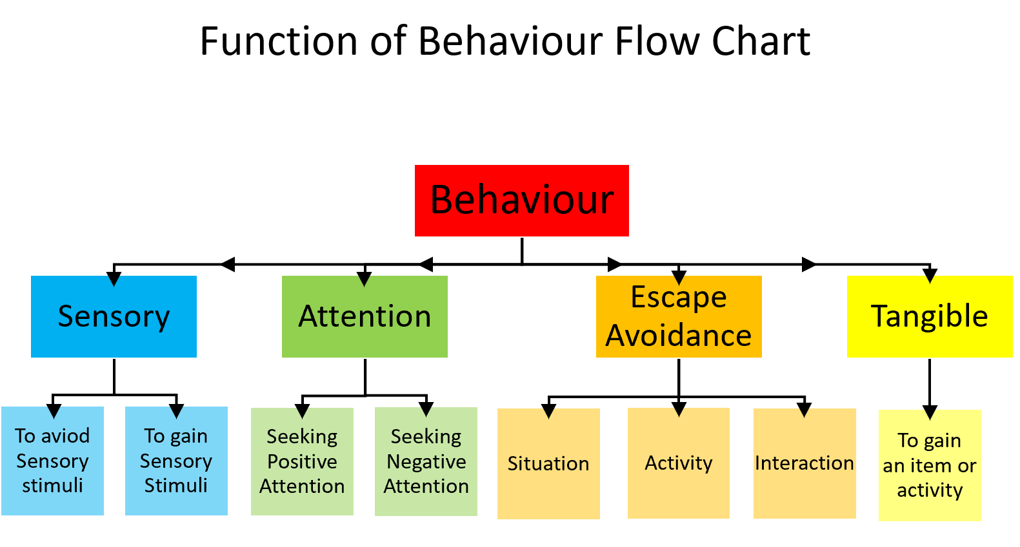
Four Functions of Behaviour Flow Chart
8

Slide 9
5 Step Behaviour Modification Process
Identify and analyse the function of behaviour and any contributing patterns
Develop strategies and behaviour support plans
Implement strategies and evaluate outcomes
Identify the challenging behaviours
Gather behaviour data for analysing
9

Slide 10
Behaviour Modification Process
Step 1 - Identify Challenging Behaviour
  Identify challenging Behavior or chosen behaviour to modify
  Through the behaviour modification process, there is less focus on the actual behaviour displayed, with more focus surrounding the antecedent and outcome.
  The actual displayed behaviour itself is often a determent of multiple internal and external factors.
  People react differently to the same stimuli.
10

Slide 11
Behaviour Modification Process
Step 2 – Gathering Behaviour Data
Behaviour data is a record of observed actions and factors
  Data is measurable, which means it can be tested, analysed and outcomes measured accurately
  The data is objective meaning the information is obtained through observations or measurement.
  Objective data limits the Influence from the observers' feelings, beliefs, interpretations and opinions.
  Observation data is often used in research papers as it is considered dependable and more accurate.
11

Slide 12
ABC – Data Collection Method
ABC data collection is an effective method of identity function and modify behaviour as it is measurable and observed.
Antecedent
Behaviour
Consequence/Outcome
Antecedent means what occurred prior or triggered the behaviour.
Information to support data -
  Environment
  Expectations or instructions
  Proximity factors
  Sensory factors
  Unpredictable changes
  Past tense factors e.g. lack of sleep or no breakfast
  Known triggers
  Social expectations
What was the observed behaviour or response to stimuli.
Information to data collection process –
  Duration of time
  Intensity of behaviour – measuring from previous observation if possible
  Frequency of behaviour, for example one or multiple chairs thrown
Consequence means what occurred immediately after as a result of the behaviour.
Data to support modification process includes –
  The response and action of others in the environment including children and adults
  Timespan between behaviour and outcome
  The actual outcome
  The consistency of the responses and outcome
12

Slide 13
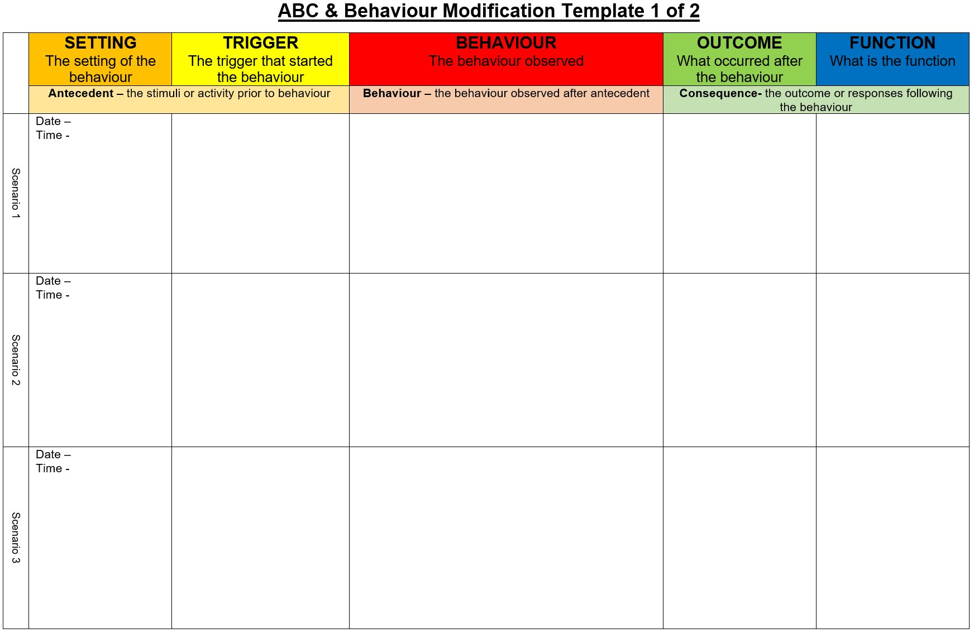
Behaviour Modification
13

Slide 14
Behaviour Modification Process
Step 3 – Analyse the data
To attempt to identify, understand and modify the behaviour consider these factors –
Ensure there is enough data collected to accurately investigate the function and identify patterns. Depending on the frequency of the behaviour although 3-5 days would be a minimum
  Look for patterns in all areas. For example:
  Time – Does the behaviour happen at the same time or at the same activity?
  Date – Does the particular behaviour only occur on particular days?
  Antecedent – is there a pattern to events, activities prior to behaviour occurring?
  Outcome – is there a pattern to some or all responses?
  One behaviour which occurs in two different environments can involve more than one function. For example:
  Calling out in class, can result in a child being removed (Escape or Avoidance), Calling out in the playground (Attention)
  Really analyse the observations, look for underlying factors or other possible functions of behaviour even if it appears obvious. Don’t assume all behaviours with the same functions are linked
  Remember behaviour is an action to seek a function
14

Slide 15
Behaviour Modification
Step 4 – Develop Strategies for Behaviour Modification
Plans or strategies will support increasing desirable behaviours and decrease challenging and unacceptable behaviours.
  Plans and strategies –
  Reduce confusion for the adults regarding expectations and responsibilities
  Provide clear expectations and strategies
  Provide a rational for the support in place
  Decrease undesirable practices and intervention methods
  Outline the new learning or skills required, which may need to be broken into small steps.
  Provide guidance and reminders regarding controllable factors and triggers
15

Slide 16
Behaviour Modification Process
Step 5 – Implementation and Evaluation of Outcomes
Evaluating the strategies and goals consistently , will provide the best possible outcomes. Factors that should be considered when implementing strategies:
  Are there any needed changes to the environment or setting?
  Any changes in the responses from adults and young people?
  What replacement behaviours will be taught?
  How will the replacement behaviour be taught?
  How will the new behaviour or skill be reinforced?
  When should I evaluate outcomes?
16

Slide 17

Key Takeaways
  Behaviours are an attempt to meet an underlying need. There are four functions or "why's" for behaviours. By understanding the why of someone's behaviour we can support regulation and behaviour modification.
  Objective data collective is imperative for the behaviour management process. Data needs to be measurable which means it can be tested, analysed and outcomes measured accurately.
  Behaviour modification is a 5-step process which identifies undesirable behaviours and supports children to develop positive strategies to overcome barriers.
17

Slide 18



Contact
Email: admin@cdbspecialists.com.au
Website: www.cdbspecialists.com.au
Online Learning Platform: https://learning.cdbspecialists.com.au
FILIT Website: www.filit.com.au
Email: support@filit.com.au
18

