Slide 1

Building Strong and Authentic Relationships with Children
KELLY OLDFIELD
GradDipPsych(Adv) BBS(Psych)
admin@cdbspecialists.com.au

Slide 2
Acknowledgement of Country
We recognise the First Peoples of this Nation and their ongoing cultural and spiritual connections to the lands, waters, seas, skies, and communities.
We acknowledge First Nations Peoples as the Traditional Custodians and Lore Keepers of the oldest living culture and pay respects to their Elders past and present. We extend that respect to all First Nations Peoples.
2

Slide 3
Introduction
Building strong and authentic relationships with children is fundamental to effectively supporting challenging behaviours. Such relationships are fostered through a combination of understanding, communication, trust, boundary-setting, and leading by example. By deeply understanding each child's individual needs and perspectives, educators and caregivers can tailor their approaches to provide the most relevant support. Open, empathetic communication further strengthens this connection, allowing for a clearer understanding of the child's experiences and feelings.
Trust is the cornerstone of these relationships, as it enables children to feel secure and supported, making them more receptive to guidance and behavioural expectations. Establishing clear boundaries helps provide structure and predictability, which is crucial for children to feel safe and know what is expected of them. Leading by example demonstrates desired behaviours and values, reinforcing the lessons being taught. Together, these elements create a nurturing environment where challenging behaviours can be addressed effectively and positively, supporting the child's growth and development.

Slide 4

Understanding the Child’s Developmental Abilities
  Understanding a child's developmental abilities is crucial for recognising their unique strengths and challenges. It is also essential when setting behaviour goals and building relationship
  Development milestones continue to the age of 13
  Having a strong understanding and relationship with the individual will support behaviours, escalations, restorative practices and relationships.
  Observing, documenting and assessing these abilities, educators and caregivers can identify specific areas where the child may need additional support or intervention.
  Setting targeted learning goals based on these identified challenges and strengths will allow for a more personalised strategies to support all developmental outcomes
    Areas of development include:
    cognitive/learning
    communication/ language
    physical/movement
    social/emotional

Slide 5

Communication
Non-verbal communication plays a vital role in building strong relationships, especially with children. Through gestures, facial expressions, and body language, adults can convey empathy, understanding, and support, which are often more impactful than words. By attuning to a child's non-verbal cues, educators can build a more trusting relationship.
  One’s body language, facial expressions and posture is always on display.
  Body language is a visual cue of what a person may be experiencing or feeling.
  Most children are visual learners.
  During escalations, body language is a key strategy so support the individual.
  It is important as educators that they are mindful of their non-verbal expressions.
  Non-verbal body language and expressions can predict the mood and behaviours of others.
  Positive reinforcement is a communication and relationship building tool
  Often negative body language will be mimicked and even cause settled children to feel unsettled.

Slide 6

Building Trust is Key
Building trust between children and educators is foundational for a positive learning environment. Trust is developed through consistent, respectful, and responsive interactions, where the child feels heard and valued.
  When educators take the time to genuinely connect with each child, showing empathy and understanding, it creates a safe space where children feel comfortable to express themselves, take risks in learning, and grow both academically and emotionally.
  A child is more likely to request for help, tell you how they are feeling and seek guidance.
  Trust isn't built on the length of time you know someone, its built on how we as educators make them feel.
  By building trusting relationships you reinforce their sense of being understood, create a sense of belonging, strengthening the relationship without compromising the necessary boundaries.
  Authoritative practices don't build trust, respect or positive relationships, they create reactive compliance based on the person response and impact to the individual.

Slide 7

Establishing Boundaries
Establishing clear boundaries and expectations is essential when building a strong child-educator relationship.
  Through predictability children develop a sense of security, helping them understand what is acceptable behaviour and what is not.
  With clear and achievable expectations in a consistent and positive manner, educators create an environment where children know what is expected of them, which fosters mutual respect and trust.
  Ensuring there is humour, nurture and structure allows for a supportive relationship that encourages children to thrive.
  Establishing boundaries doesn’t mean you always need to change a child’s perception, opinion, or point of view. Instead, it’s about validating their feelings and thoughts, which helps build trust and mutual respect and supports relationships
7

Slide 8

Leading by Example
Leading by example is a powerful way to build relationships with children. How educators react, behave and address challenges or adversity within the environment, will reflect on how others respond.
  Educators who consistently model positive behaviours, such as kindness, respect, and honesty, will support children are more likely to mirror these actions in their own interactions. Especially if the child has a positive relationship with the educator.
  Demonstrating these values in daily routines and interactions not only teaches children important life skills but also fosters a deep sense of trust, connection and relationship.
  By embedding these qualities, you wish for children to learn, develop and practice, educators create a supportive environment where strong, authentic relationships can flourish.
  Showing children how to react and respond when mistakes or challenges are presented, will show the child we are human, and we make errors.
  Increase engagement due to the role modelling of the educators.

Slide 9

Educator Reflective Practices
Reflective practices are essential for educators in building and maintaining strong relationships with children. Regularly reflection on interactions and openness to feedback will assist in what's working well and what needs adjusting.
  Self-assessment allows educators to continue to develop and refine skills
  Support growth for educators and students within the setting
  Supports the wellbeing of students and educators in the environment
  Review all plans and practices relationships with children are built on a foundation of trust, acceptance and understanding
  Improves collaboration as individuals who are willing to work together, share ideas and support one another can lead to more productive and successful outcomes

Slide 10

Challenging Behaviour
A strong relationship built on trust and respect can make children more receptive to guidance and support, leading to improved behaviour. Positive relationships are crucial for effectively supporting children with challenging behaviours and fostering their overall development and well-being. When children feel valued and understood, they are more likely to engage positively in learning and social activities.
  Positive relationships can help children develop better emotional regulation skills, as they feel safe and supported in expressing and managing their emotions.
  Investigate the function of behaviour the behaviour through observations and interactions
  A positive relationship creates an open line of communication, allowing educators to better understand the child’s needs and work together to address challenging behaviours effectively.
  When children experience consistent support and validation, their self-esteem and confidence improve, which can reduce the frequency of challenging behaviours.

Slide 11

Challenging Behaviour
  Provide an environment where the child can return with a clean slate and positive relationship with educators are more likely to take on strategies and guidance
  Increased motivation will increase the likelihood to engage in more learning or activities without the avoidance-based behaviours.
  Strong relationships support and accelerate the process and results of behaviour modification practices because the individual trusts the people involved and their intentions.
  Strong relationships contribute to a more harmonious and productive classroom environment, benefiting all students.

Slide 12
Conclusion
In conclusion, building strong and authentic relationships through understanding, communication, trust, boundary-setting, and leading by example is essential for effectively managing challenging behaviours in children. These foundational elements create a supportive environment where children feel valued and secure, which enhances their willingness to engage in positive behaviours. When educators and caregivers prioritise these aspects, they not only address immediate behavioural issues but also foster long-term emotional and social development.
Thankyou

Slide 13

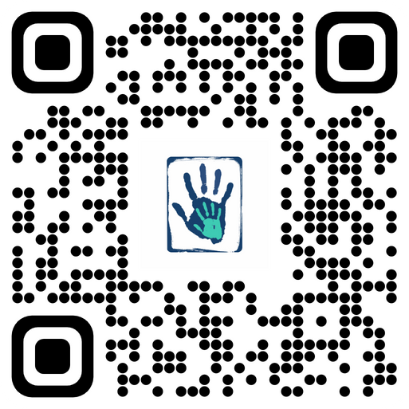

Contact
Email: admin@cdbspecialists.com.au
Website: www.cdbspecialists.com.au
Online Learning Platform: https://learning.cdbspecialists.com.au
FILIT Website: www.filit.com.au
Email: support@filit.com.au
13

